Slide 1
EEE 335 Principles of Operating Systems
Principles of I/O Software – Pt 2
(Modern Operating Systems 5.3)

Slide 2
Quick Review
What is implied by the following principles?
Device Independence
Uniform Naming
Error Handling
Synchronous vs. Asynchronous transfers
Buffering
Sharable vs. Dedicated devices
Notes:
Last lecture, we discussed the IO from Software Perspective (not from Hardware and Controllers View). We revised the busy-wait, interrupt-based, and DMA methods for IO handling. We discussed some principles we would like to achieve from the IO software. We discussed the concept of the device driver and how it handles IO instructions and convert them from the high level abstract representation (read/write) into instructions that the device controller can understand (sector, cylinder, track, head …etc).
Today, we are going to discuss more about the IO software.
Device Independence
Should not have to specify the specific I/O device in advance when writing a program
Uniform Naming
The name of the device should not depend on the device
Error Handling
Handle errors as close to the hardware as possible
Synchronous vs. Asynchronous transfers
Want many events appear to the user as synchronous/blocking when the are, in fact, interrupts
Buffering
Data may have to be buffered to improve performance/prevent errors
Sharable vs. Dedicated devices
OS should allow for some devices to be shared and others to be dedicated.

Slide 3
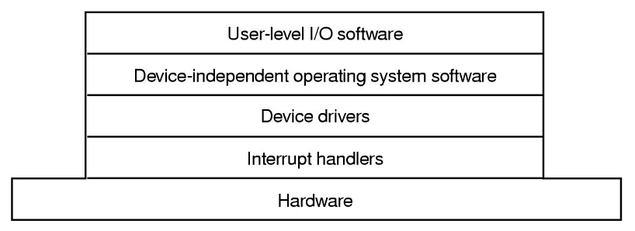
Outline
Device-Independent OS software
User-level I/O software
I/O Software layers summary

Slide 4
Device-Independent I/O Software
Device drivers must have very particular implementations to interact with each device
However, the operations used to interact with I/O should be largely the same across device classes. All files should have open, write, read, functions. Network devices will need to have connect/disconnect, status, etc...
Above the drivers is a layer of device-independent software so that programmers do not have to understand the particulars of each device specifically, but each class in general
Notes:
All the user wants to know is “Read”, “Connect” …etc. Regardless of the device. So, we can say “Read, Write, Open, Connect, …etc” is an interface that each driver MUST implement so the OS and the user code will not change when a new device is introduced. This is the main functionality of the “device-independent” IO Software.

Slide 5
Device-Independent I/O Software
Typical functions of the independent layer:
Uniform interfacing for device drivers
Buffering
Error reporting
Allocating and releasing dedicated devices
Providing a device independent block size
The fundamental goal for having device-independent software is to:
Perform the I/O functions that are common to all devices
Provide uniform interface to user-level software
Notes:
The basic function of the device-independent software is to perform the I/O functions that are com

Slide 6
Device-Independent I/O Software
1) Uniform Interfacing for Device Drivers
This is where all devices from a similar group are made to look the same to the layers above
If this was not performed, every time a new device printer (ie: Lexmark 2050) was added to the system then the OS would have to be modified
Big gain in this system: drivers can “easily” be added to the system as long as they support the interface above and below

Slide 7
Device-Independent I/O Software
1) Uniform Interfacing for Device Drivers
The manufacturer of the driver will have to be told by the OS maker what functions calls it must support and what kernel functions it is allowed to call
This layer is also responsible for mapping symbolic device names to a specific device driver
For example, in Linux if a floppy is mounted at /dev/disk0, the OS must locate the driver to be used by determining the specific device mounted at that location
Notes:
When you read a file from CD-ROM or Floppy, it is the same read operation that you use in the hard disk. How the OS determines which driver to use, it is the job of the device-independent IO Software.

Slide 8
Device-Independent I/O Software
2) Buffering
Why is buffering an issue?
Consider a modem. Receiving one character at a time would be inefficient as the user program would have to be woken up for each receipt
The user space program could instead provide a buffer into which the characters will be written. What happens if the buffer is paged out?
The kernel can hold the buffer. But what happens if the buffer is being copied to the user buffer when a character arrives? Two buffers are required so that while one is being copied, the other may be written to
No buffer
User buffer
Kernel buffer
Notes:
Buffering increases speed of processing.
No buffer, awake the user program with each character
User Buffer, good but risky if buffer is paged out. Interrupt service procedure puts characters into this buffer
Kernel Buffer in addition to the user buffer, good but “overflow” can happen. Overflow means a character is coming and the user buffer is not ready to take it yet.
Use a double Kernel Buffer or circular buffer

Slide 9
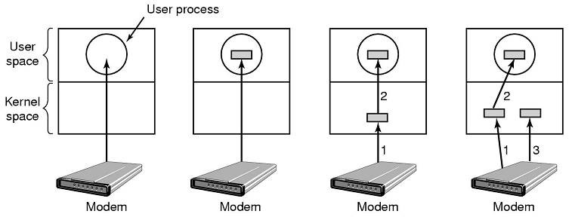
Device-Independent I/O Software
2) Buffering
A scheme such as the one on the far right is known as double buffering
While one buffer is being copied to user space, new data is put into the other one
Output buffering is also important: the user’s buffer must be copied to kernel space to await transmission so that the user program can continue to modify the buffer
Notes:
Buffering increases speed of processing.
No buffer, awake the user program with each character
User Buffer, good but risky if buffer is paged out
Kernel Buffer in addition to the user buffer, good but “overflow” can happen. Overflow means a character is coming and the user buffer is not ready to take it yet.
Use a double Kernel Buffer

Slide 10
Device-Independent I/O Software
2) Buffering
Buffering is done at the device independent level since it would be inefficient and produce inconsistent results to have each device driver do the work
Each device class will have different buffering requirements.
For example:
SATA HDD – 8,16, 32 MB buffer
NIC card – 48KB, 96KB
Notes:
Why buffering is not handled in drivers ?. Again, to unify and abstract the implementation. All devices share the same buffering method so the user program does not change if device is changed.

Slide 11
Device-Independent I/O Software
3) Error Reporting
There are two classes of error at this layer:
Programming errors – the user process asks for the impossible such as writing to a mouse, reading from a printer, or accessing a file that has not been opened
Actual I/O errors – An attempt has been made to write to the disk but the operation failed at the physical level. If the driver cannot handle the issue (perhaps by trying to write again) the problem is passed to this layer
This layer is responsible for collating the errors that may happen and reporting them to the user in a consistent manner when required

Slide 12
Device-Independent I/O Software
4) Allocating/Releasing Dedicated Devices
The device independent layer is where devices that can be used by only one user at a time are allocated and released
If the device is not available either an error message must be reported or the user process must be blocked until the device is free
Notes:
The device – independent IO SW handles the access to devices (dedicated or shared).

Slide 13
Device-Independent I/O Software
5) Provide a Device-Independent Block Size
Related to providing a similar interface to a group of devices, for example:
If a network card receives information in 32-bit chunks, but the modem requires bytes,
this translation should be handled here and be invisible to the above layers
Notes:
Again, this hides the HW details (block size) from the user. The user program sees only ONE standard size. The modem is an example. Modem uses bytes but the network card works on a standard of 32 bits. It is the job of Device-Independent I/O Software to handle this invisibility from the user.

Slide 14
User-Space I/O Software
Note that although almost all I/O software resides within the kernel, a small amount will exist inside user space as well
From where? The libraries that you must include to use functions such as open/close/read/write are included as part of your program
These library procedures are clearly part of the I/O subsystem
Spooling is also considered as part of user space as it is simply a user space program with the permission to access the printer “file”
Notes:
We all know the “stdio.h”. It is a library that will link to our user program that handles IO calls. This library hides the details of dealing with the device-independent IO SW. It is again, the same idea, abstraction and interfacing for simplifying the developers’ life. Here, it hides details of OS (the device-independent IO SW) from the user. The side effect of this of course is that developers, with time, become less knowledgeable about the science, art, secrets, and details of IO devices and the OS in general.
Another example of User-Space IO SW is the Spooling system. Spooling deals with dedicated devices (printer) in a multiprogramming system.
Daemon process watches “Spooling Directory” and print files in it. Here, this Daemon is the printer “manager”. This Daemon is a User Space Process (Why????).

Slide 15
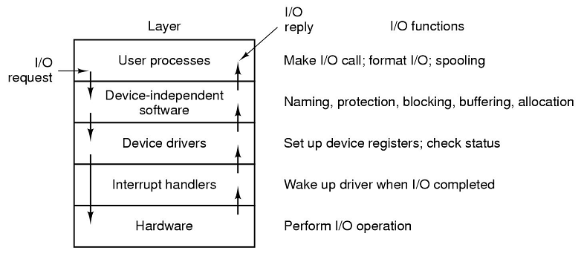
I/O Software Layers Summary
Note how the interrupt handler layer is skipped on the request but, obviously, not the reply
Notes:
Follow through the steps shown here.
User process makes a library call, such as read
The device independent layer sets up any required buffers and translates the request to the proper device driver, and blocks the user process if required
The driver communicates with the device and blocks.
The device generates the information to fulfill the request and generate an interrupt
The interrupt handler awakens the device driver
The device driver provides the information up to the next layer, probably by filling the buffer indicated earlier
The device-independent software fills the requesting process’ buffers with the information and awakens that process.

Slide 16
Quiz Time
What are the layers of the I/O system?
Notes:
What are the layers seen overall for the I/O system?
User Space I/O Software
Device Independent Layer
Device Drivers
Interrupts
Hardware

